Slide 1


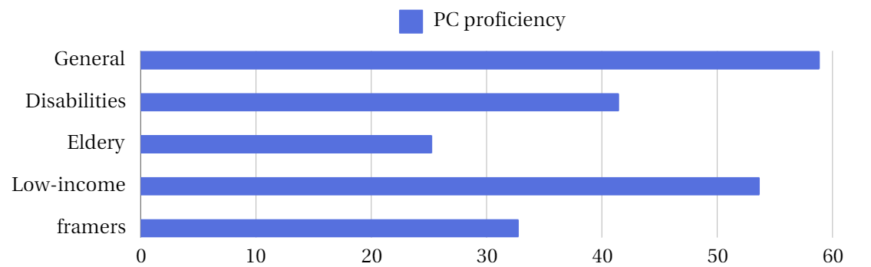
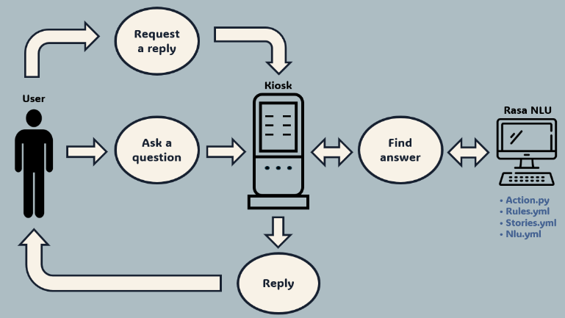
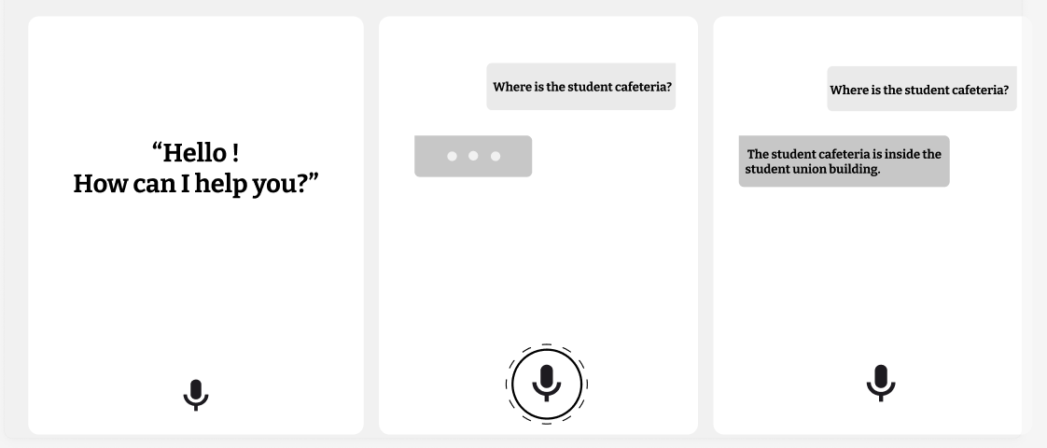
Design of Generative AI-based Speech-Recognizing KIOSK for Educational Institutions
Eun-kyung Jung¹, Na-yeong Kwon¹, Bo-mi Lee¹, Sang-jo Baek¹, Ji-soo Ryu², Kee-sung Kim³
¹Gyeongbuk ICT Advanced Talent Training Center, Daegu Catholic University, Gyeongsan, Rep. of Korea
²Dept. Of Research & Development, DREAM IDEA SOFT Ltd. Inc, Daegu, Rep. of Korea
³School of Computer Software, Daegu Catholic University, Gyeongsan, Rep. of Korea
ABSTRACT
This paper discusses the development of an AI voice recognition-based kiosk for digitally marginalized groups, such as the elderly and users with physical limitations. By utilizing natural language processing (NLP) and generative AI models, the system interprets user intent and proposes a conversational system design that provides facility guidance and service information in public and educational institutions through voice.
INTRODUCTION
With rapid advances in information technology, society faces a widening digital divide. As of 2023, the digital literacy and competence of Korea's vulnerable groups, such as the elderly and low-income, were significantly lower than others (Fig. 1). Existing kiosks use GUI-based systems, which are difficult for many in these groups to use. This research proposes a new kiosk system utilizing AI-powered voice recognition to simplify interactions. Through natural language processing, users can navigate and access services more easily, ensuring equal access to technology for all.
Figure 1 PC proficiency of Korean
Design method
A. Fuctions
Fig. 2 The kiosk system by Dream Idea Soft works like this: It uses Rasa NLU to recognize the user's voice question, understand the intent, and provide the right response. Rasa Core manages the conversation flow through files like Action.py, Rules.yml, Stories.yml, and Nlu.yml, which are used for setting rules, story flow, and intent/entity settings. After understanding the user's intent, it scores the answer to give the most accurate response, and it also includes a simple chatbot for casual conversations.
Question
Question Recognition
Find Answer
Answer Voice Output
Correct Answer
End
Variable
Kiosk Screen Question Display
Find Logic
Variable
Standard Language
Incorrect Answer
Dialect
Jargon
Slang
Figure 2 Functions
Figure 3 Scenario
B. Scenario
Fig. 3 explains the process of how a system handles a user query. The process starts with the user inputting a question, and the system analyzing the language type (standard, dialect, slang, etc.). After recognizing and processing the question, the system displays it on the kiosk screen. It then searches for an appropriate answer, either from a database or through logical analysis. The answer is delivered via audio output. If the answer is incorrect, the system loops back to refine the answer. Once the correct answer is provided, the process concludes. This flowchart visually represents the entire query-to-answer process.
C. Kiosk Interface
Fig. 4 shows a speech recognition kiosk's user interface, designed to optimize user interaction. Key design elements include welcome messages, voice recognition status indicators, real-time text feedback, and intuitive user interfaces. By integrating these elements, a user-friendly and efficient kiosk system is implemented, accessible to users of all ages and technical skill levels.
Figure 4 Kiosk Screen
Conclusion
In conclusion, this research aims to enhance digital accessibility for the digitally marginalized by introducing a generative AI-based voice recognition kiosk system. By providing an intuitive, user-friendly interface, the system promotes inclusivity and empowers individuals to access essential services more easily. Continuous improvements and tailored solutions across various sectors will ensure the system remains effective and scalable, ultimately contributing to reducing the digital divide and fostering a more equitable technological landscape.
Acknowledgment
This research was supported by “Regional Innovation Strategy(RIS)” through the National Research Foundation of Korea(NRF) funded by the Ministry of Education(MOE)(No. 2022RIS-006).

